Slide 1
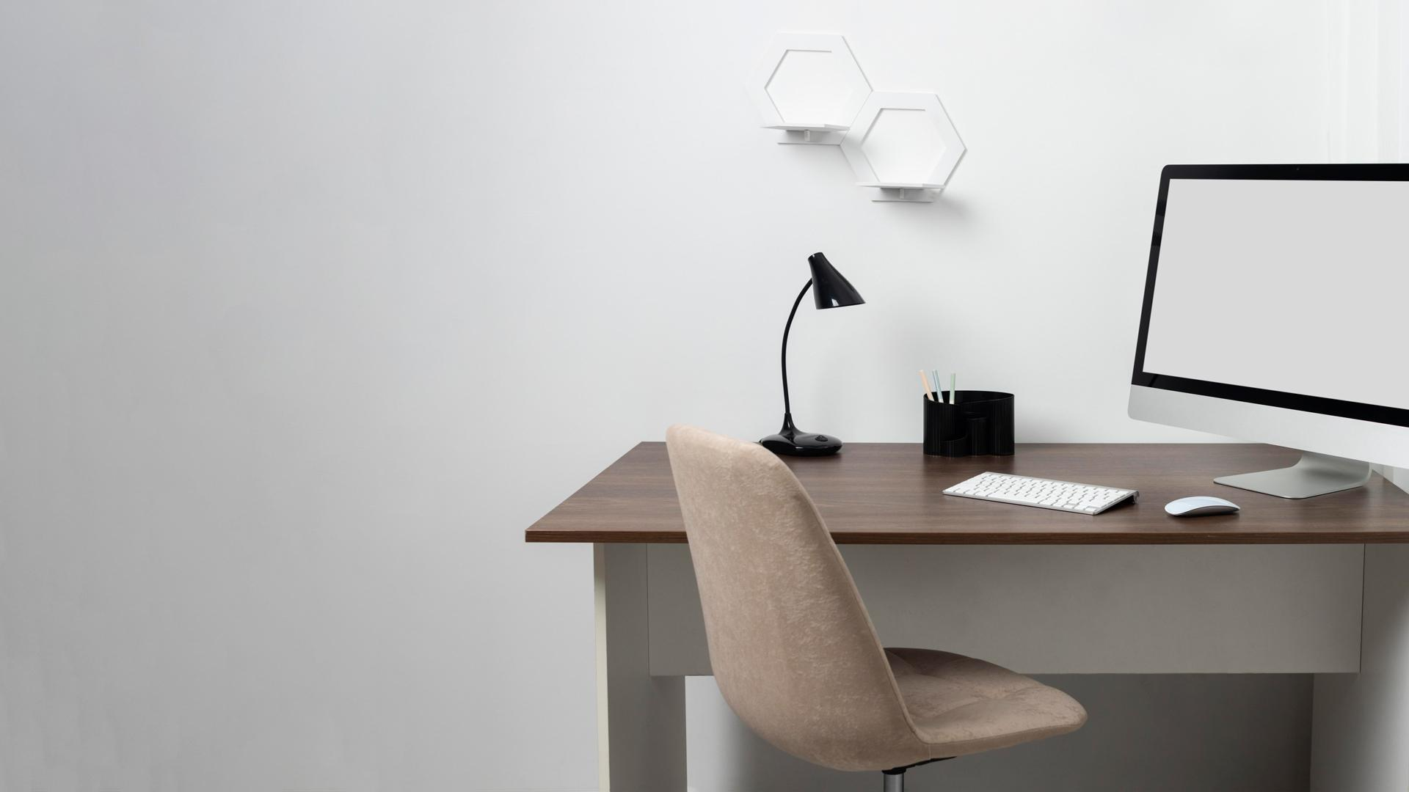
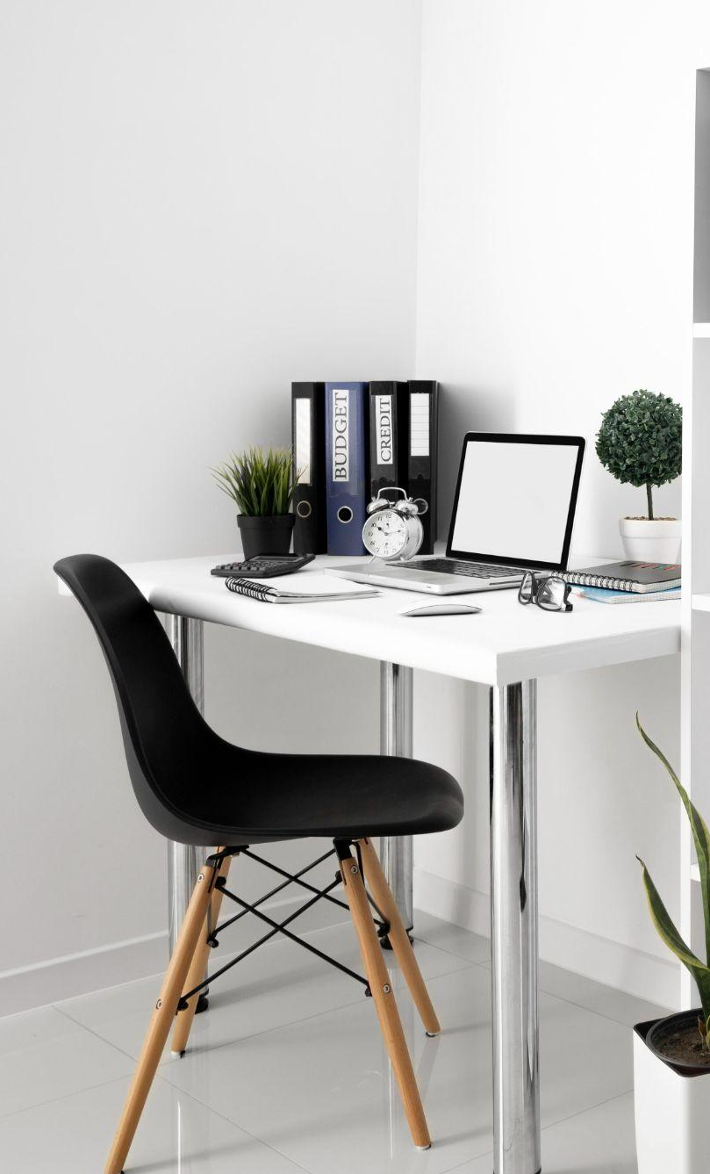
Intelligent Interior Design Search Engine Using Multi-Modal AI Techniques
Supervised by Dr. Soha Ahmed Ehssan

Slide 2

Table of contents
01
02
03
04
05
06
Introduction
Dataset
CV
NLP
Fusion
Web App
07
Conclusion

Slide 3
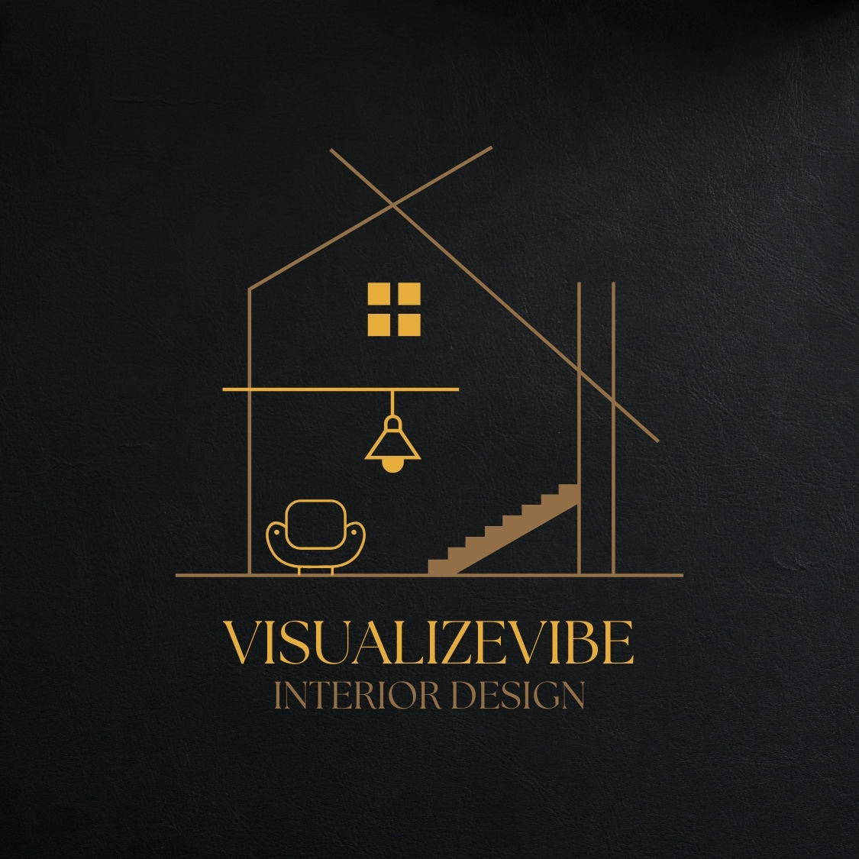
01 Introduction
In this project, we address the challenge of helping users visualize and personalize their interior spaces by developing a multi-modal interior design search engine.

Slide 4
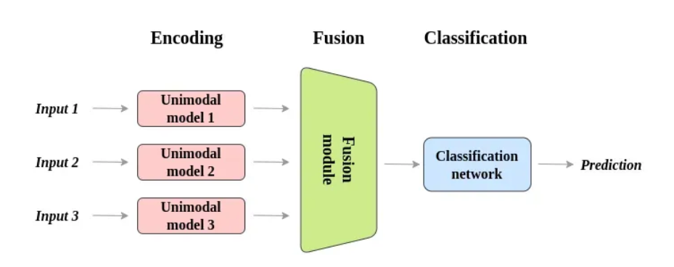
MultiModal Model
Ranking & similarities
Definition
It’s trained to integrate and analyze data from various sources, including Multimodality (e.g., text, images, audio, and video)
Ranking & similarities

Slide 5
02 Dataset
Collected Dataset
YOLOv8 Dataset
It contains 14 categories, e.g: chair and bedroom.
Each individual item and room scene provided with its textual description.
No dataset is publicly available, hence we collected our dataset.
We were able to download 2900 images of room scenes and individual items.
COCO Dataset didn’t cover all our classes.
Customized Dataset contains 5 classes with annotations.
Label Image.
Divided into train, test and validation datasets.

Slide 6
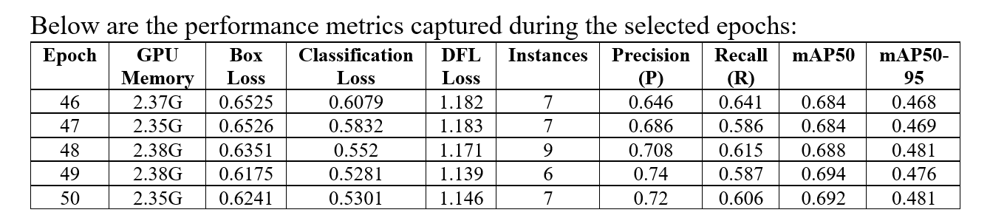
Training Details (YOLOv8)
02 Dataset

Slide 7
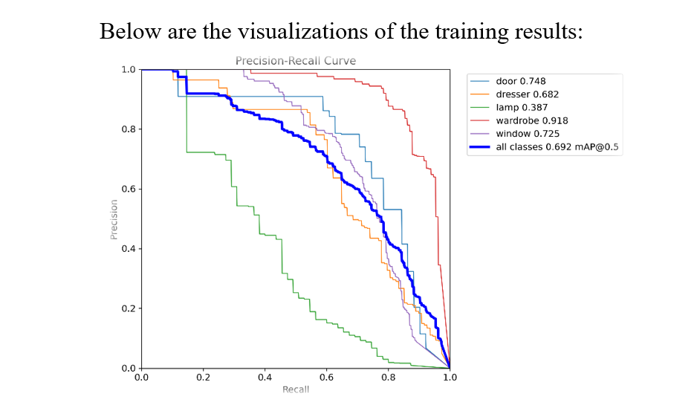
02 Dataset

Slide 8
03 CV
Visual Search
Image Encoding with ConvNeXt:
Object Detection with YOLOv8:
Feature Extraction: Extracts detailed visual features from images, capturing essential characteristics for similarity comparison.
High-Dimensional Vectors: Creates embeddings that represent the visual aspects of each image.
Real-Time Detection: Utilizes YOLOv8 for efficient and accurate detection of multiple objects within images.
Custom Training: Fine-tuned on our dataset of interior items, ensuring high detection accuracy.
Optimization: Enhanced parameters like detection confidence threshold for better performance.

Slide 9
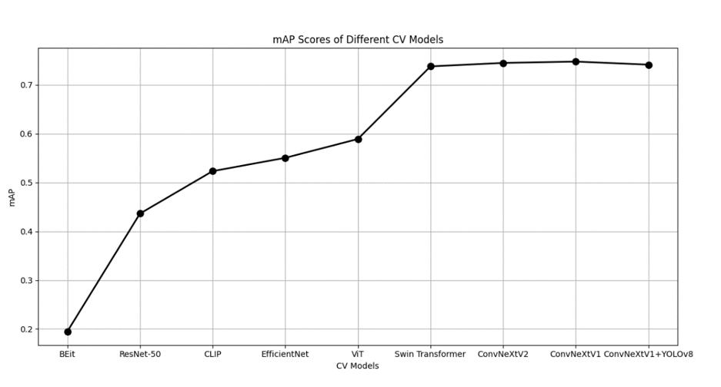
03 CV
Results:

Slide 10
04 NLP
Textual Search:
Ensembling:
Textual Embeddings with SBERT and RoBERTa:
Ensembling refers to the technique of combining multiple models or representations to improve performance. In this case, embeddings from SBERT and RoBERTa are combined to create more robust text representations
Semantic Understanding: Generates meaningful textual embeddings to interpret and process complex queries.
Contextual Nuances: Captures the semantic content of textual descriptions, enabling effective text-based search.

Slide 11
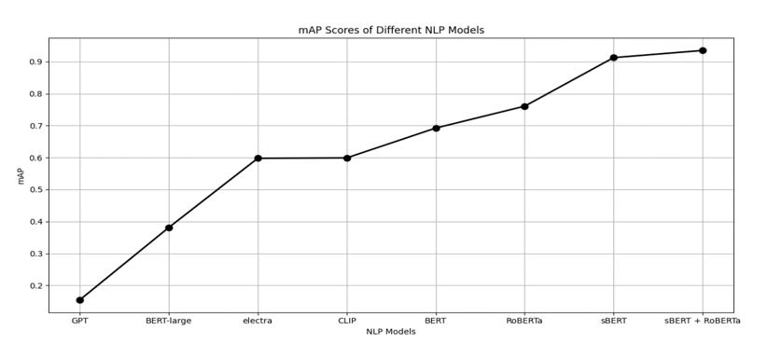
04 NLP
Results:

Slide 12
04 Fusion
Similarity Measurement:
Cosine Similarity: Measures similarity between query embeddings and dataset embeddings, ensuring relevant search results.
Ranking: Sorts and presents results based on similarity scores, highlighting the most relevant items.
Feature Fusion Techniques:
Multi-Modal Fusion: Combines visual and textual features into a unified representation for accurate search results.
Balanced Contribution: Uses weighted averaging and normalization to ensure both modalities contribute effectively.
Evaluation and Optimization:
Metrics: Assessed performance with mean Average Precision (mAP).
Tuning: Refined parameters for optimal results.

Slide 13
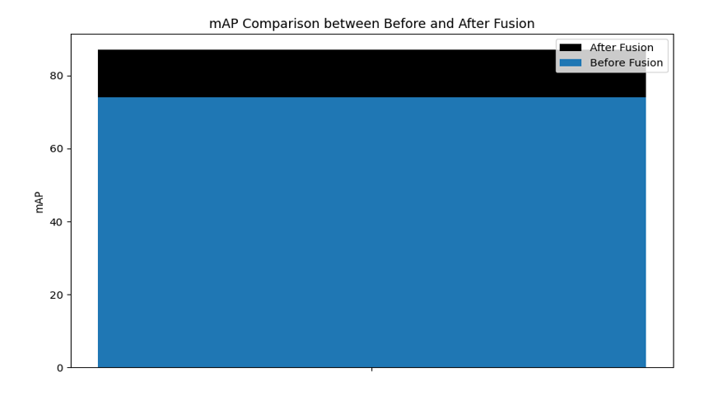
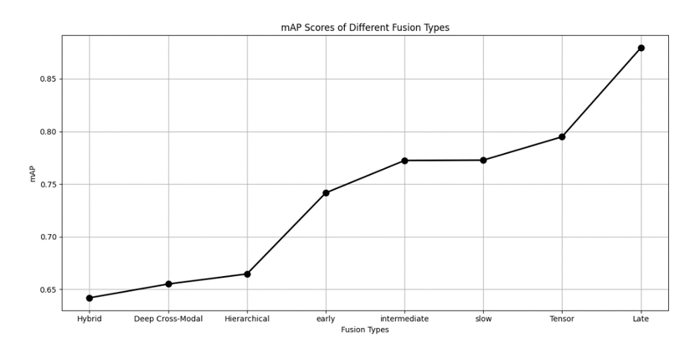
06 Fusion
Fusion for Similarity Calculation
Fusion for Similarity Calculation

Slide 14
07 Conclusion
Our multi-modal interior design search engine represents a significant advancement in helping users visualize and personalize their living spaces. By integrating state-of-the-art AI technologies such as YOLOv8 for object detection, ConvNeXt for image encoding, and SBERT and RoBERTa for textual embeddings, we have created a robust and intuitive platform that combines visual and textual search capabilities.
Key Achievements:
Advanced Model Integration: Successful implementation of cutting-edge models for object detection, image encoding, and text understanding.
Comprehensive Dataset: Collection and annotation of a diverse dataset for train yolo and another dataset for evaluation contains 2900 images and detailed descriptions.
Feature Fusion: Development of algorithms to combine visual and textual features, ensuring accurate and relevant search results.

Slide 15
07 Conclusion
Future Enhancements:
Voice Search and Mobile App: Implementing voice-based search and developing a cross-platform mobile application for greater accessibility.
Multi-Language Support and Personalization: Adding support for multiple languages and personalized recommendations.
Enhanced Visualization and E-commerce Integration: Developing 3D visualization tools and integrating with e-commerce platforms for direct purchases.

Slide 16
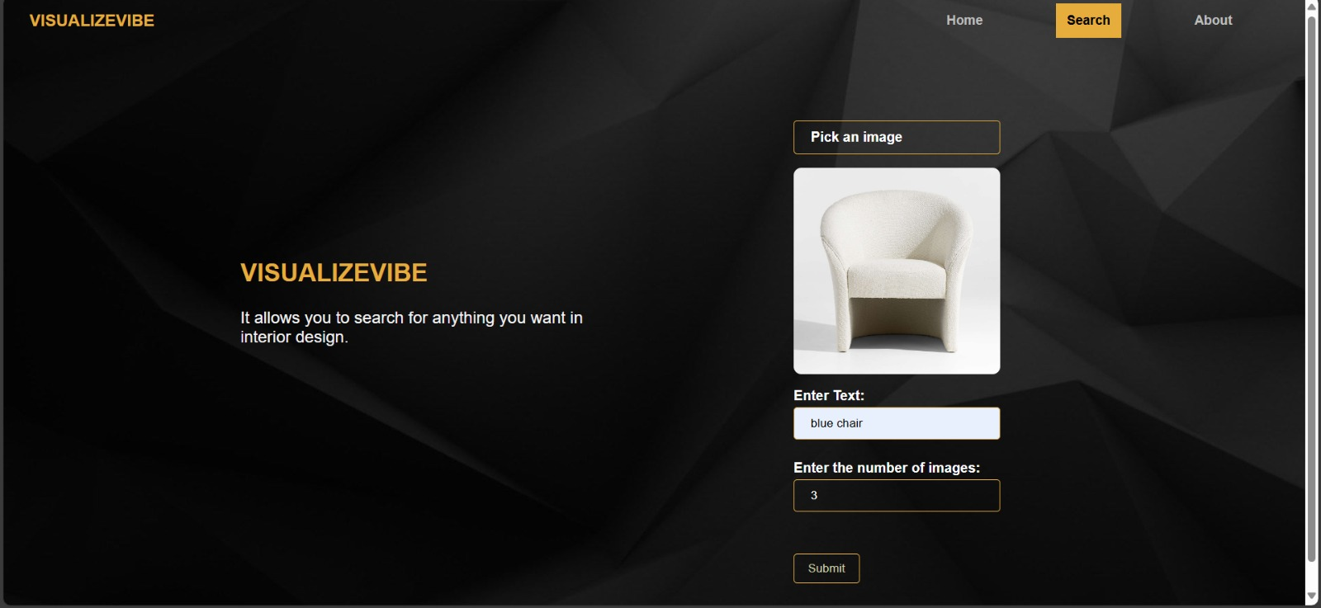
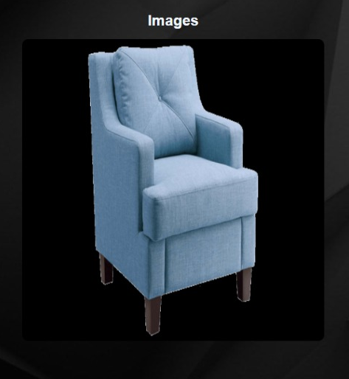
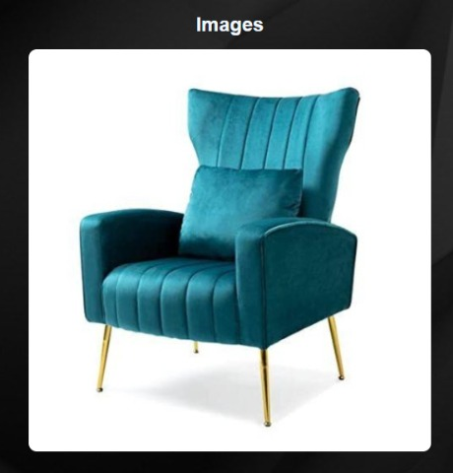
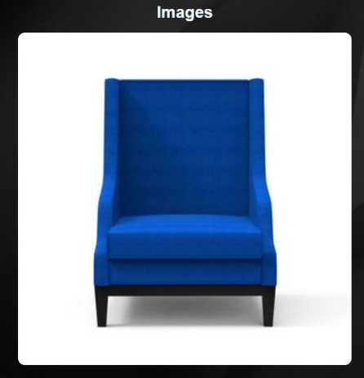
06 Web App
Input
Blue chair
3 images
Output

Slide 17

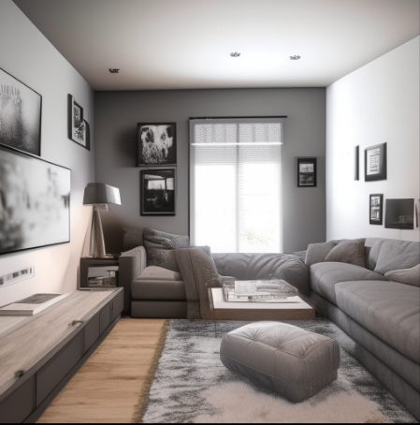
07 Conclusion
Future Enhancements:
Image generation: We can use an image generation model to let our users
imagine their items or their rooms
Image to image:
Input:
Text: "living Room, Sofa, chair, Grey walls ,tv“
Image:
Output:

Slide 18
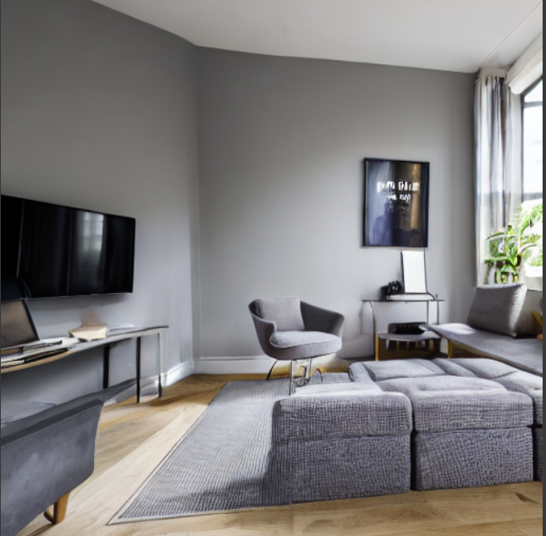
07 Conclusion
Future Enhancements:
Image generation: We can use an image generation model to let our users
imagine their items or their rooms
Text to image:
Input:
Text: “An image of living room with a tv and chair and sofa with grey walls”
Output:

